Slide 1




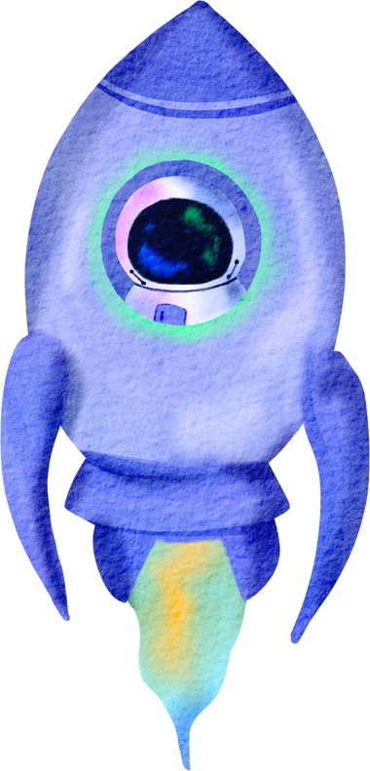



UNVEILING THE MYSTERY
OF EXOPLANETS
By Exoview Innovators

Slide 2


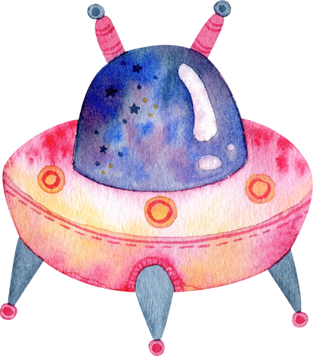





Meet Our Team
Khadija
Dua Sami

Slide 3

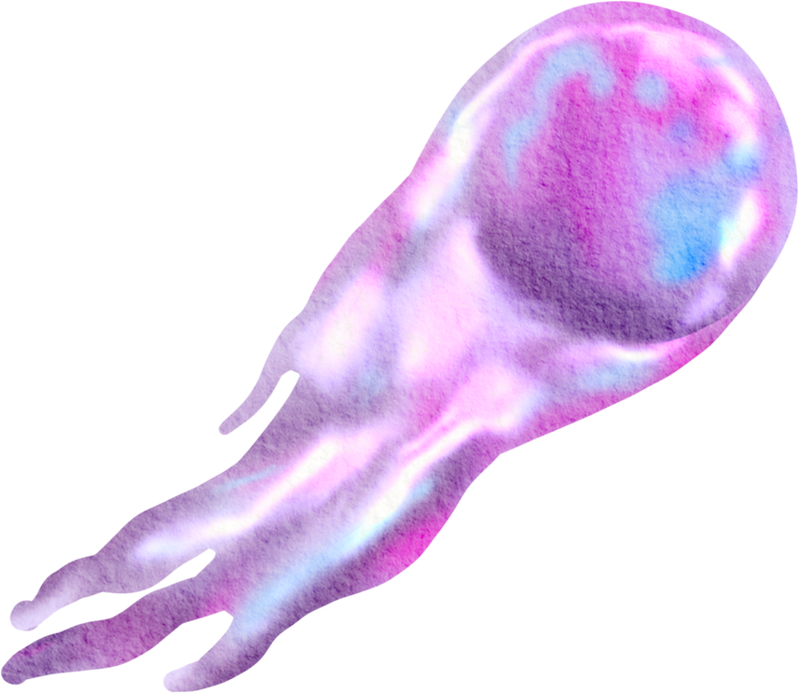





Introduction
Welcome to our journey beyond the boundaries of our solar system, where we explore the fascinating world of exoplanets. As advancements in astronomy continue to evolve, exoplanet discovery has become one of the most exciting fields of space exploration. Through this website, we aim to provide an engaging platform that explains how scientists uncover these distant worlds, using cutting-edge techniques.
Our website not only introduces the methods used to detect exoplanets but also presents detailed information about some of the most famous and intriguing exoplanets discovered to date.

Slide 4





What are Exoplanets
Most exoplanets discovered so far are within a small region of our Milky Way galaxy, within a few thousand light-years of Earth. Even the closest exoplanet, Proxima Centauri b, is 4 light-years away. We know that planets outnumber stars in the galaxy, and by measuring their sizes and masses, we've found a wide variety of compositions—from rocky, Earth-like planets to gas giants like Jupiter. Some exoplanets are dominated by ice, iron, or carbon, while others feature extreme environments such as molten surfaces or low-density, puffy atmospheres.

Slide 5




Why Exoplanets Matter?
1
By studying exoplanets in the "habitable zone," scientists aim to find Earth-like planets that may support life or potentially serve as future homes for humanity.
2
Exoplanets, ranging from gas giants to rocky worlds, reveal a remarkable diversity that enhances our understanding of planetary formation and evolution.
The exploration of exoplanets is primarily driven by the quest to determine if extraterrestrial life exists, as scientists investigate distant planets in habitable zones to understand whether conditions suitable for life could be found beyond Earth, thereby enhancing our comprehension of biology and the universe.
3

Slide 6






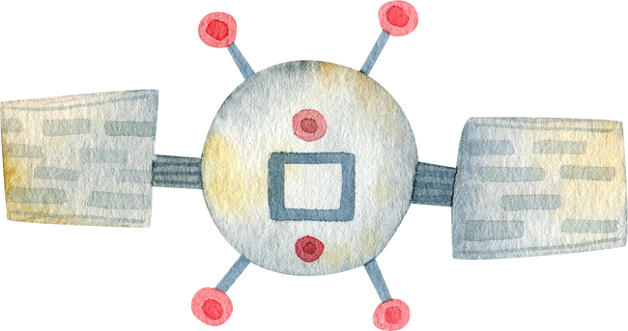




Educate the public about exoplanets, their significance, and the methods used for their discovery.
Create an interactive platform where users can explore information about exoplanets and contribute to discussions about their implications for life beyond Earth
Project Goals
Support ongoing scientific research and interest in exoplanet exploration by providing easily accessible resources and up-to-date information.
Showcase the technological advancements and methodologies used in exoplanet discovery, emphasizing the role of missions like Kepler and TESS (Transiting Exoplanet Survey Satellite).

Slide 7


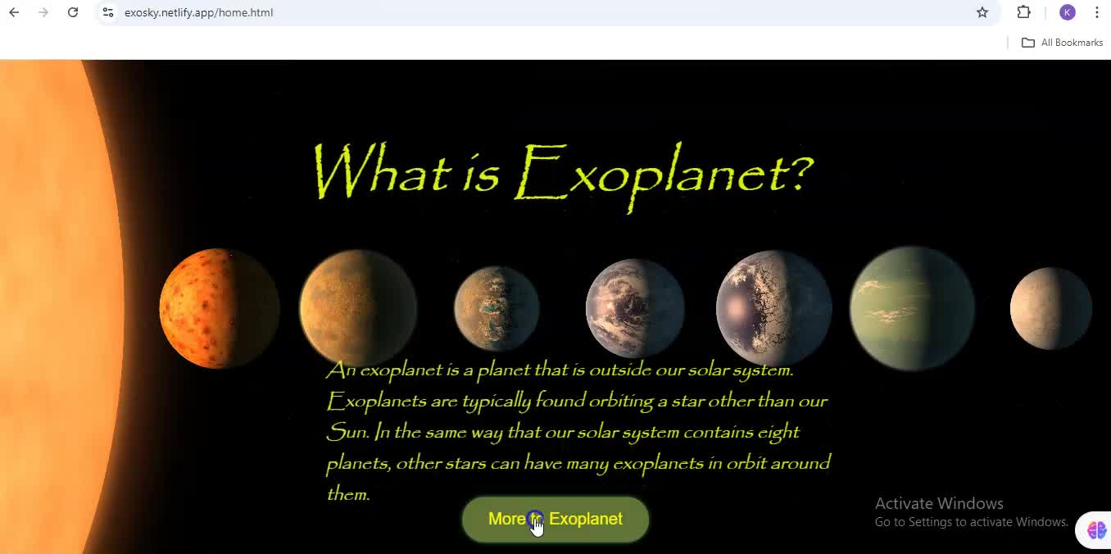
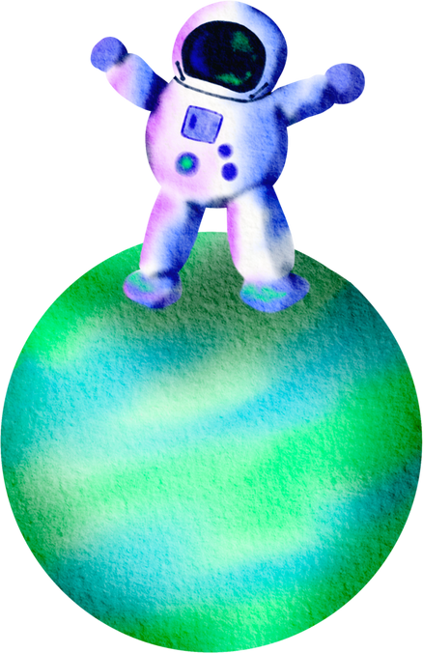

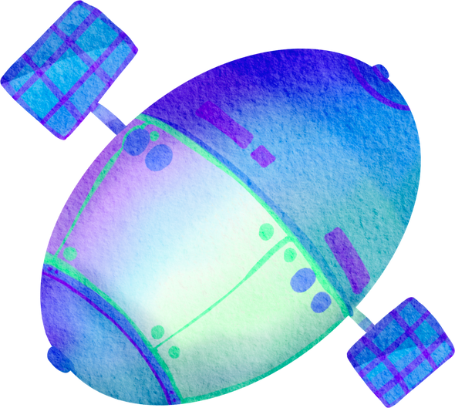
Project Demo

Slide 8
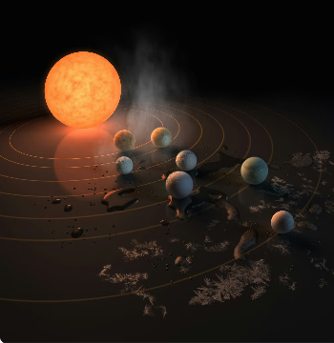


Future Idea
Imagine a 3D model website where users can explore exoplanets as if they are standing between them. This immersive experience could provide a unique way to learn about exoplanets and their characteristics. Such a platform could include interactive features, detailed information, and stunning visuals to engage users.

Slide 9



Project Links
Github Repository
https://github.com/19khadij/NasaChallenge_Khadija.git
Deployed Link
https://exosky.netlify.app/

Slide 10
References
Images and Content were gathered from
Canadian Space Agency (CSA)

Slide 11








